Slide 1






ESEC/FSE 2018
FraudDroid: Automated Ad Fraud Detection for Android Apps
Feng Dong, Haoyu Wang*, Li Li, Yao Guo, Tegawende F. Bissyande, Tianming Liu, Guoai Xu and Jacques Klein

Slide 2
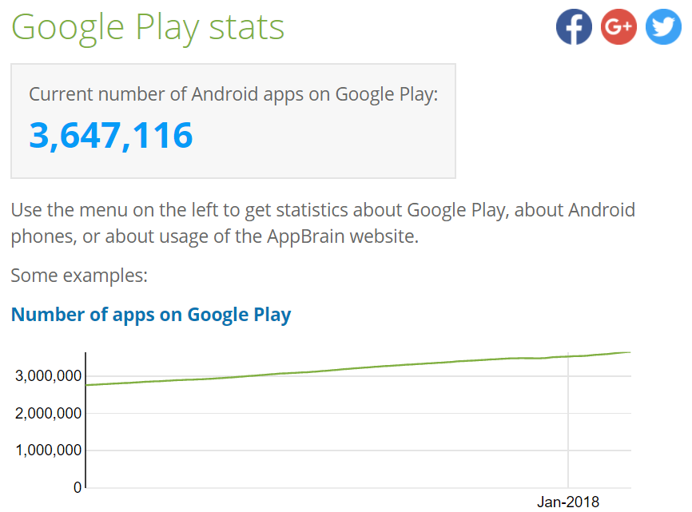
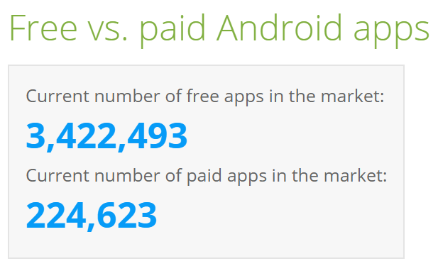
Mobile apps are increasingly popular
More than 90% of the apps are free
The Number of Apps in Google Play has surpassed the 3.6M mark in 2018
*data from https://www.appbrain.com/stats/
Notes:
移动应用在近年来发展飞速，不同的应用市场中都有数百万移动应用。
大部分应用都是免费应用

Slide 3
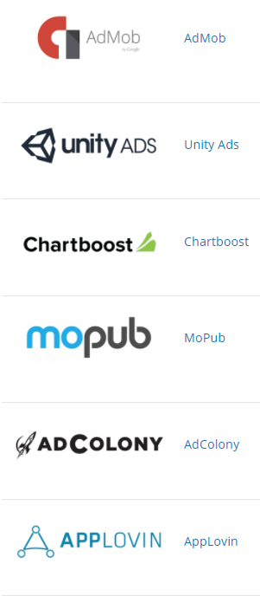
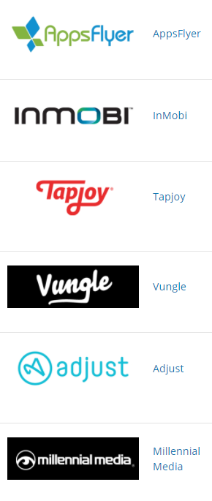
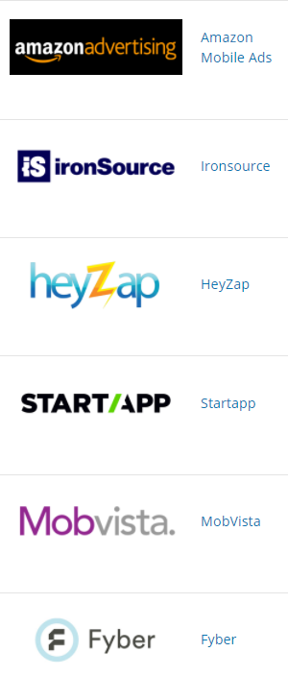
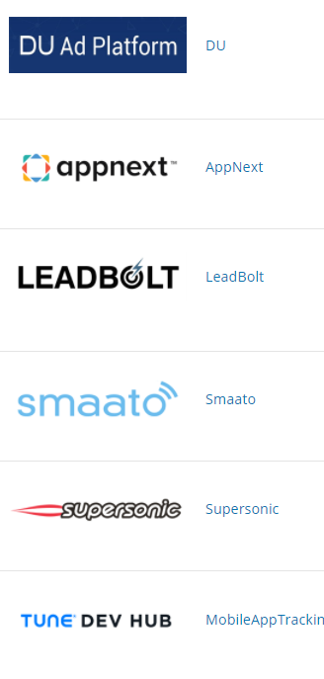
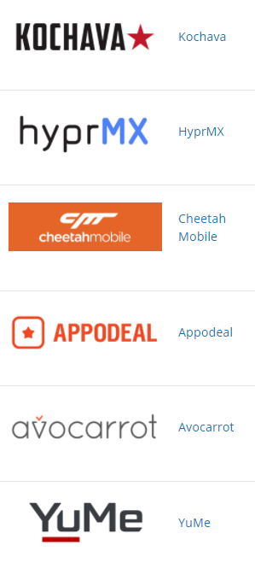
Ad Libraries are Widely Used by Developers
Notes:
广告是免费应用赚钱的主要方式。
除了Google Admob以外，国内外也有数百种不同的广告平台。

Slide 4
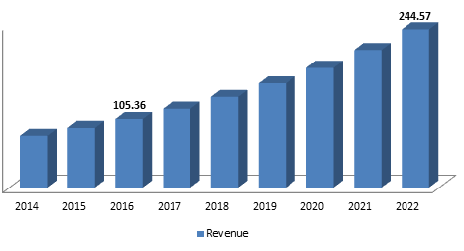
Mobile Advertising is Big Business
Advertisement drives the economy of the app ecosystem
The revenue of mobile advertising will achieve 244 billion by 2022
*from Zion market research 2017
Notes:
因此，整个移动广告生态规模非常大，在2014年移动平台广告规模就已经超过PC平台，并且预计在2022年将达到2400亿美元的规模。

Slide 5
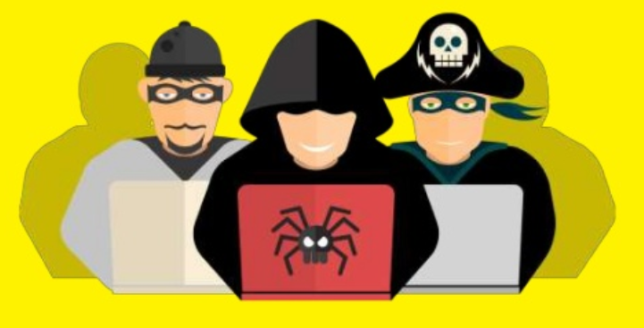
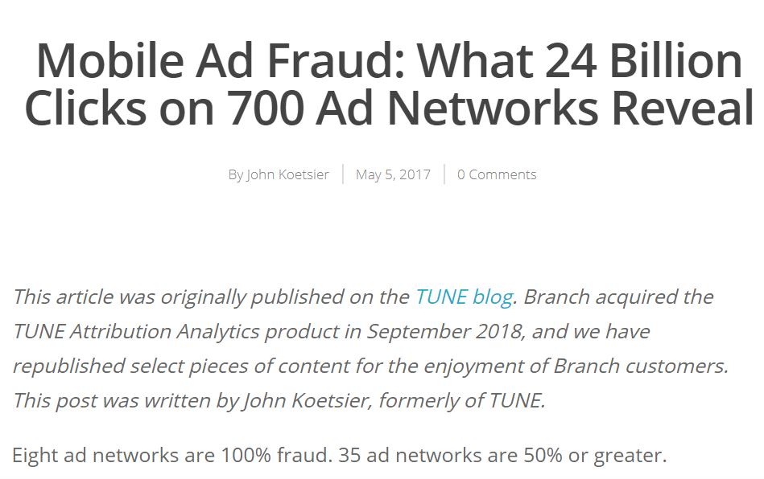
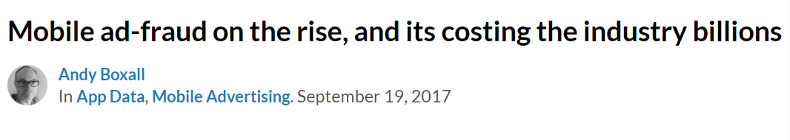
And Where There Is Money …
There are those who follow it
Notes:
有利益的地方，就有黑产。
移动广告平台巨大的利益，也吸引了大量的恶意开发者和黑客。
据报道，每年因为移动广告欺诈所造成的损失高达数十亿美元。

Slide 6

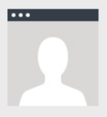

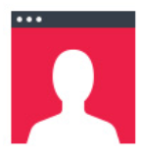

Mobile Ad Fraud
Traditional Ad Fraud
Fraud Type | Click/Impression | User | Characterized By
Click Fraud |  |  | Stolen Credit for A Real User
Install Fraud |  |  | Artificial User
Compliance Fraud |  |  | Mis-served Ads
Notes:
传统的广告欺诈只关注于虚假的广告展示和广告点击，
点击欺诈（身份盗用）
即使广告还没有显示的时候，真实用户的设备上模拟可以模拟的点击事件进行欺诈。 这是一个高回报的欺诈方式，因为它只需要一个假的动作
安装欺诈（假模拟）
安装欺诈是一种用来模拟真实人类行为的策略，实际上是100％虚假的。 这种欺诈形式旨在快速扩大用户群并提高营销人员的成本。
合规欺诈（盗用资金）
这种欺诈的特征是在渠道同意的条件之外环境中投放的广告。 这种策略用于吸引廉价的流量，同时欺骗营销人员支付溢价。
这种欺诈形式吸引真正的用户，但由于它们不是投放活动的目标用户，所以他们可能不是高质量用户或营销人员期望获得的价值用户。

Slide 7
However, the deception techniques used by app developers are even getting more sophisticated
Notes:
然而随着移动广告平台的发展以及移动平台的特性，我们也发现一些新兴广告欺诈形式。

Slide 8


Dynamic Interaction Frauds
tricking users into unintentionally clicking ad views while they are interacting with the app UI elements

Slide 9
FraudDroid
perform an exploratory study of a wide range of new ad fraud types in Android apps
propose an automated approach for detecting them in large-scale market apps
Notes:
因此，我们这篇工作关注于移动平台的新兴广告欺诈，提出一种方法检测这些新兴广告欺诈， 并且在大规模市场中进行分析

Slide 10
A taxonomy of mobile ad frauds
Approach: investigate the example policy violations
the ad usage policies (e.g., admob, adsense, doubleclick)
the developer policies provided by app market
Wandoujia, Huawei and Tencent Myapp
the guidelines on ad behavior drafted by China Communications Standards Association
Real-world cases (aggressive adware)
Notes:
首先，我们对广告欺诈做了一个分类。

Slide 11
A taxonomy of mobile ad frauds
Mobile Ad Fraud
Static Placement Fraud
Dynamic Interaction Fraud
Hidden
Size
Number
Overlap
Interaction
Drive-by Download
Outside
Frequent
Non-content

Slide 12
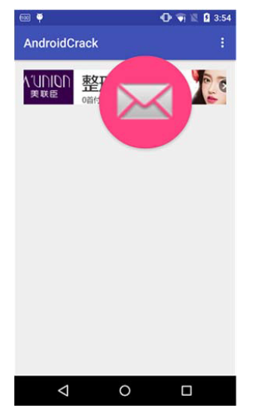
Static Placement Fraud (1) : Ad Hidden Fraud
Policy Regulation
“Ads should not be placed underneath buttons or any other object which users may accidentally click while interacting with your app” from Google Admob Policy
Key Behavior
App developers may hide ads (e.g., underneath buttons) to give users the illusion of an “ad-free app”
forest.best.livewallpaper

Slide 13
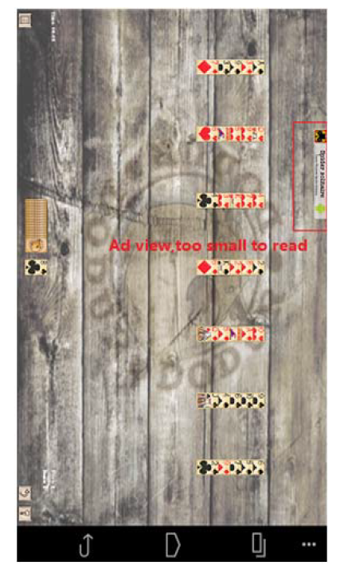
Static Placement Fraud (2) : Ad Size
Policy Regulation
the size ratio between the ad and the screen is required to be reasonable, allowing the ads to be viewed normally by users (admob, wandoujia)
extremely small ad sizes
app developers may provide the feeling of an ad-free app, however cheating advertisers;
abnormally large ad size
attract users’ attention (while affecting their visual experience), or forcing them to click on the ad in an attempt to close it.
com.dodur.android.golf

Slide 14

Static Placement Fraud (3) : Ad Number
Policy Regulation
the number of ads must remain reasonable
Key Behavior
Place more than 3 ad views in a UI state
degrading the usage experience of the app, and even severely affecting the normal functionality when ad content exceeds legitimate app content.
com.CrazyRunGame1.Templeqqq

Slide 15
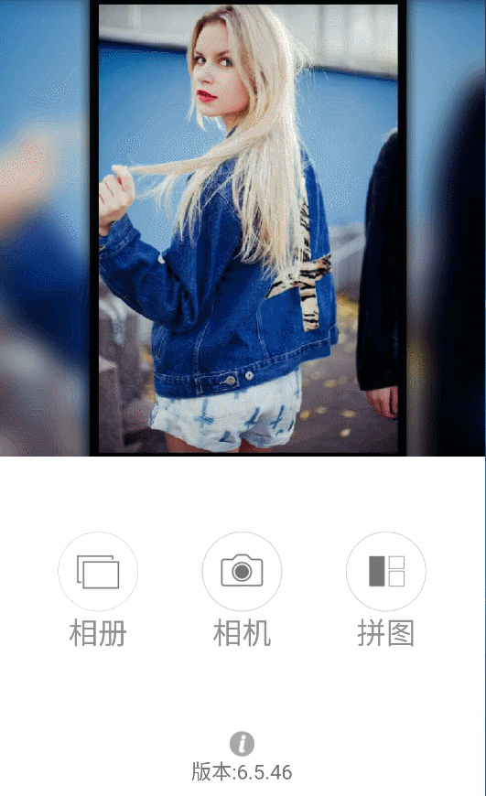
Static Placement Fraud (4) : Ad Overlap Fraud
Policy Regulation
Ads should not be placed in a location that covers up or hides any area that users have interest in viewing during typical interaction. Ads should not be placed in areas where users will randomly click or place their fingers on the screen
display ad views on top of actionable functionality-relevant views
Force users into triggering undesired impressions and clicks
com.baiwang.instasquare
wqkswopelavtjpbmtfvxak

Slide 16
Dynamic Interaction Frauds (1) - Interaction Ad fraud
Ad views are placed when transitioning between UI states
frauds can be performed by placing ad views early on app load or when exiting apps
trick users into accidental clicks since interaction with the app/device is highly probable at these times
com.android.yatree.taijiaomusic
Notes:
“Dynamic” implies that the
detection of these frauds occur at runtime. “Interaction” implies
that the fraudulent behavior is exploiting user interaction scenarios
and may involve multiple UI states.

Slide 17

Dynamic Interaction Frauds (2) - Drive-by download fraud
Triggering unintentional downloads when the ad view is clicked on
Heavily impacts user experience, and in most cases, drive-by downloads cannot even be readily cancelled.
com.bugunsoft.BUZZPlayers

Slide 18
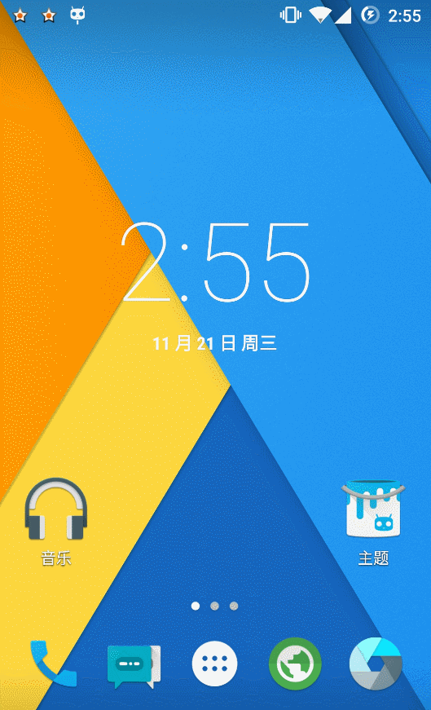
Dynamic Interaction Frauds (3) – Outside Ad Fraud
Ads should not be placed in apps that are running in the background of the device or outside of the app environment
com.ChangStory

Slide 19
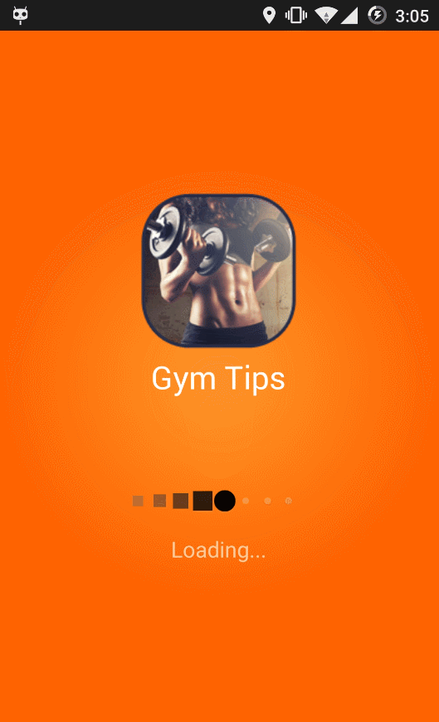
Dynamic Interaction Frauds (4) – Frequent Ad Fraud
developers may implement fraudulent tactics by displaying interstitial ads every time the user performs a click on the app’s core content
com.fitness.gym.tips.besttips

Slide 20
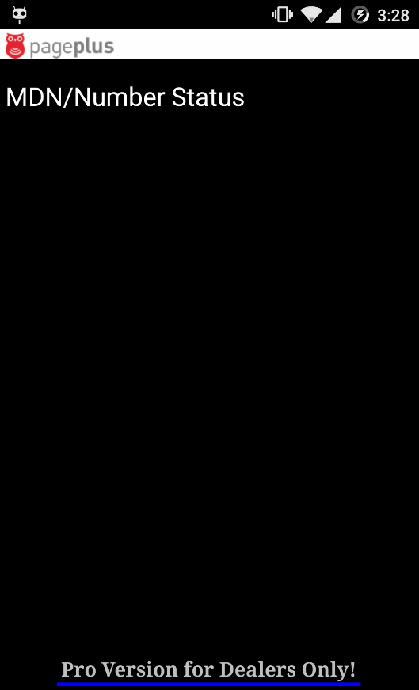
Dynamic Interaction Frauds (5) – Non-content Ad Fraud
Publishers are not permitted to place ads on any non-content-based pages such as thank you, error, log in, or exit screens
Ads on these types of UI states can confuse a user into thinking that the ads are real app content
com.pageplusstatus

Slide 21
Automated Ad Fraud Detection
Challenges
Dynamically exercising ad views in a UI state
Automatically distinguishing ad views among other views
Key Techniques
Transition graph-based UI exploration
Call-stack and feature-based Ad view Detection
Heuristics-supported ad fraud detection

Slide 22
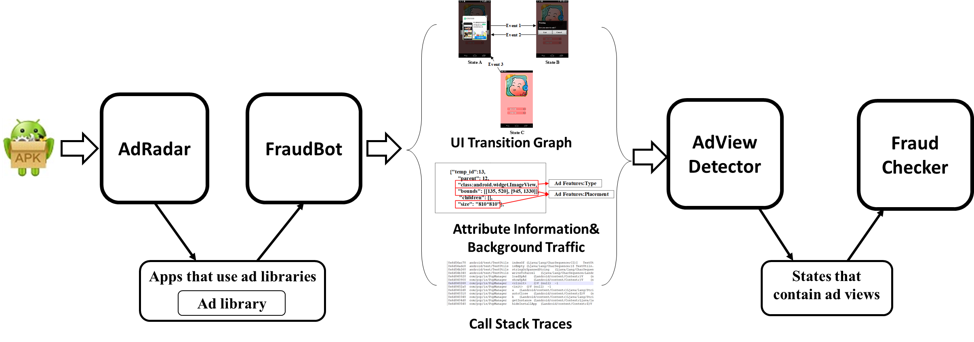
FraudDroid: Automated Mobile Ad Fraud Detection
AdRadar: identify apps that embed ad libraries
FraudBot: collect UI information and generate the UI transition graph at runtime
AdView Detector: identify ad views in a given state.
FraudChecker: to assess whether the ad view is appearing in a fraudulent manner

Slide 23
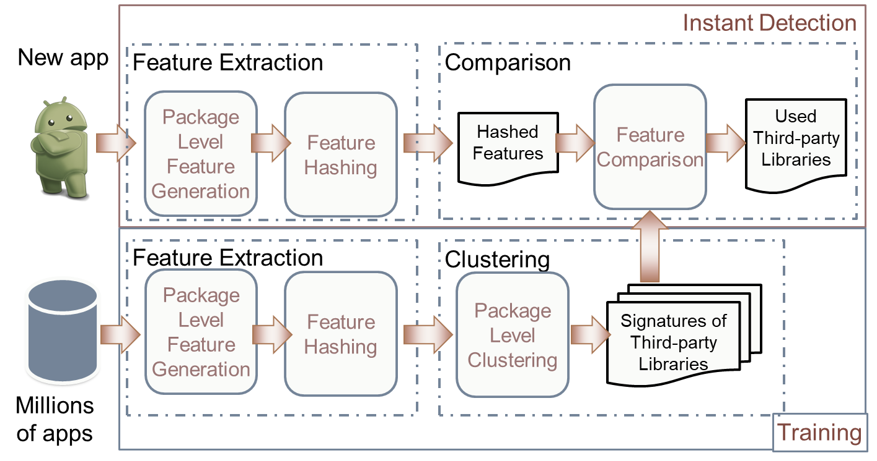
AdRadar: identify apps that embed ad libraries
we have applied the clustering-based approach introduced in our previous work LibRadar [ICSE 2016 Demo] to 3 million apps
We have manually labeled 282 ad libraries (56,011 versions)

Slide 24
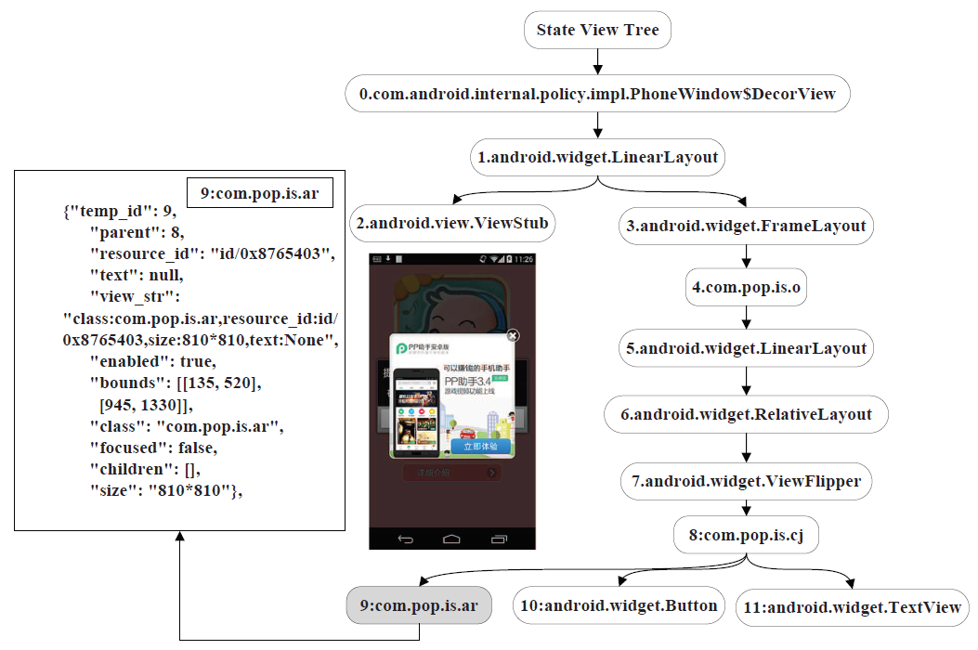
UI State Transition Graph Construction
Step 1: Construct View Tree for each UI State
State: A running page of the app
View: element or control
Construct View Tree
Use google Accessibility to understand the layout
obtain information from each view such as name, size and class name

Slide 25
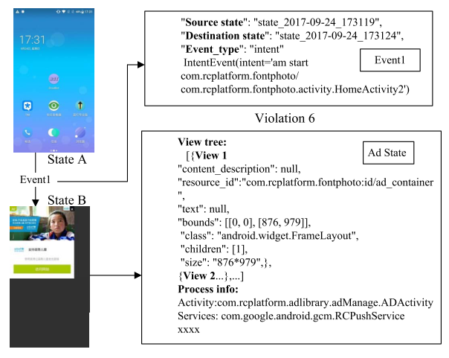
UI State Transition Graph Construction
Step 2: App Automation
Observation
90% of the UI states do not contain any ad views
more than 90% of ad views are displayed in either the main UI state or exit state
Exploration Strategy
BFS strategy
Ad first traversal strategy
An example of UI state transition graph
Notes:
get the view list from the current state
choose the event input for the next view

Slide 26
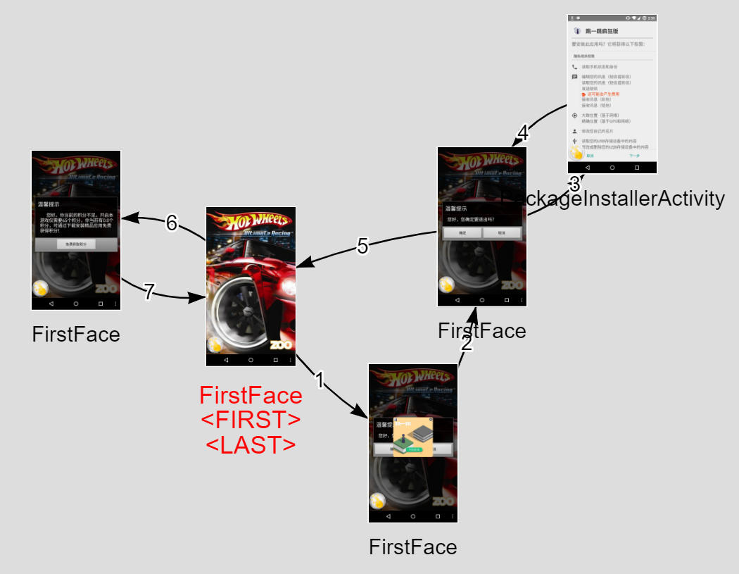
FraudBot ：The UTG of Motivating Example
Notes:
换成动图

Slide 27
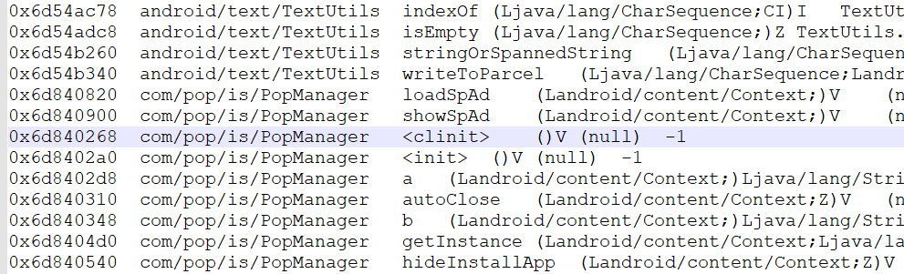
Identifying Ad Views (1/2)
Step 1：Identifying the states that contain ad views
=>Call Stack based approach
During the process of generating the UI state transition graph, we record the call stack traces of each UI state.

Slide 28
Identifying Ad Views (2/2)
Step 2：further locate the ad views
Aspects | Attribute | Value
String | Resource ID | AdWebview, AdLayout, ad_container, fullscreenAdView, FullscreenAd, AdActiviry, AppWallActivity, etc.
Type | Class | ImageView, WebView, ViewFlipper
Placement | Size (Bounds) | 628*800 [Center], 320*50 [Top or Bottom], 1776*1080 [Full Screen], etc.

Slide 29
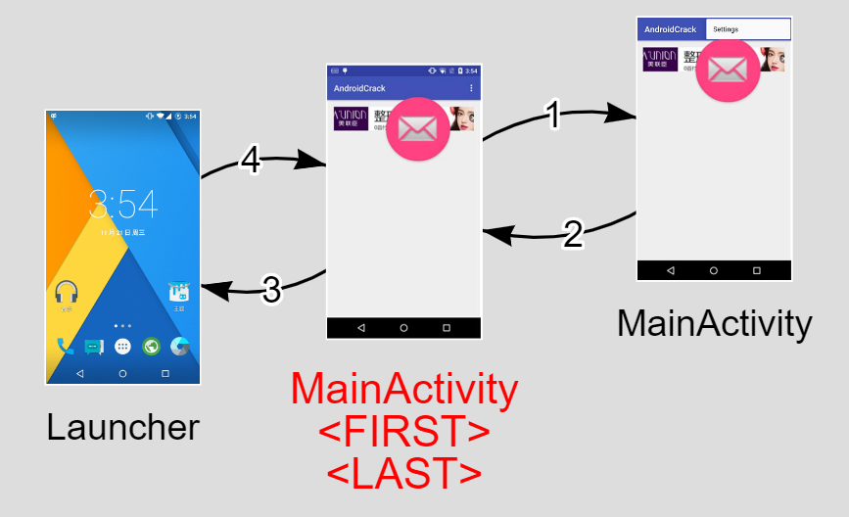
Heuristics-supported ad fraud detection
Fraud #1: Ad Hidden
forest.best.livewallpaper

Slide 30
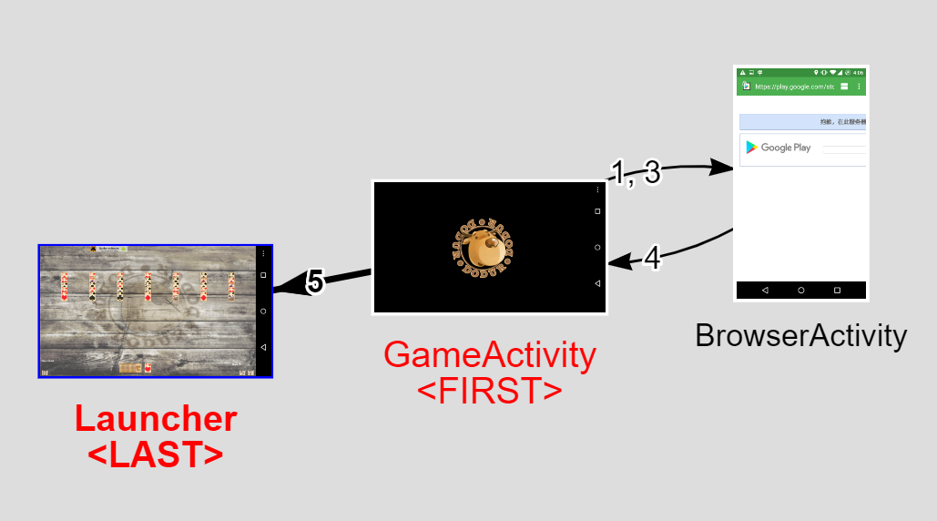
Heuristics-supported ad fraud detection
Fraud #2: Ad Size
com.dodur.android.golf

Slide 31
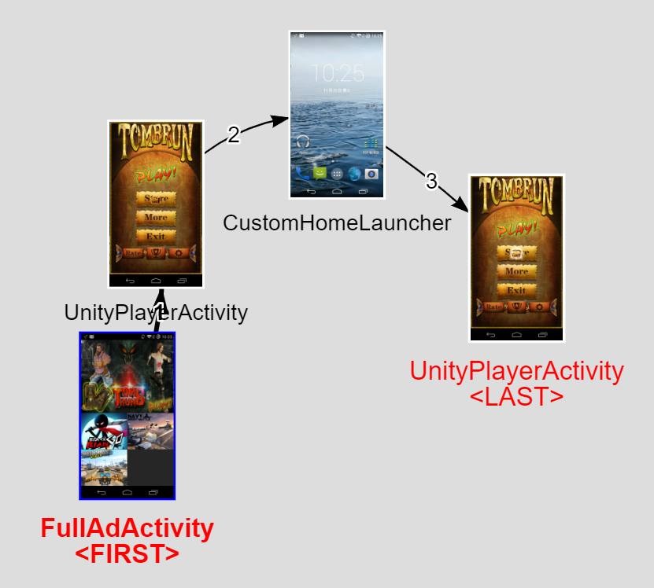
Heuristics-supported ad fraud detection
Fraud #3: Ad Number
com.CrazyRunGame1.Templeqqq

Slide 32
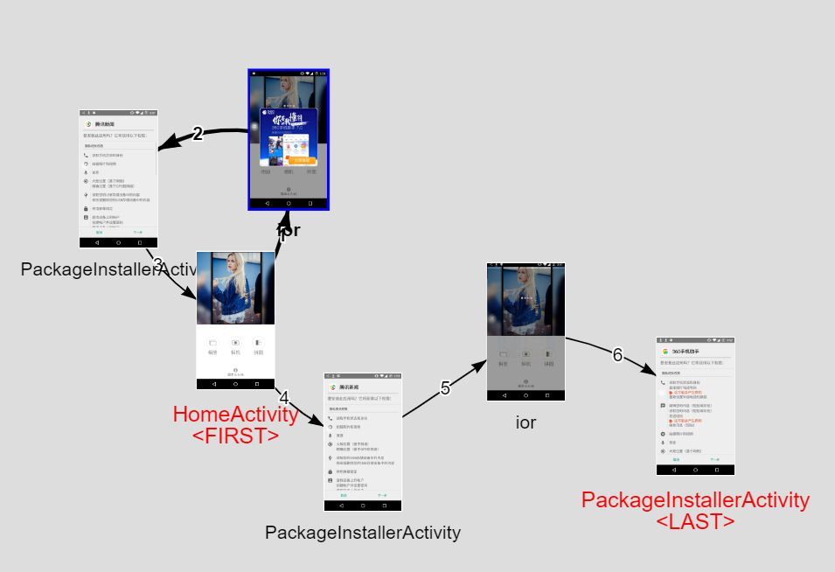
Heuristics-supported ad fraud detection
Fraud #4: Ad Overlap
com.baiwang.instasquare
wqkswopelavtjpbmtfvxak

Slide 33
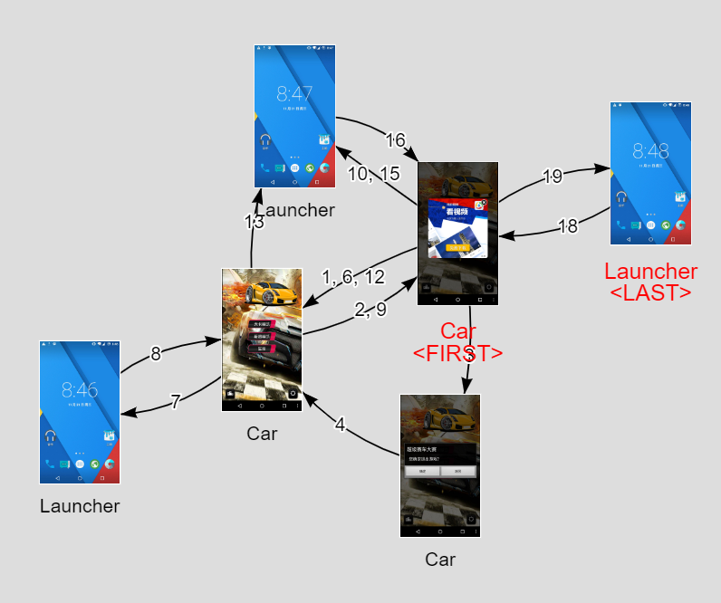
Heuristics-supported ad fraud detection
Fraud #5: Interactive Ad Fraud
com.android.yatree.taijiaomusic

Slide 34
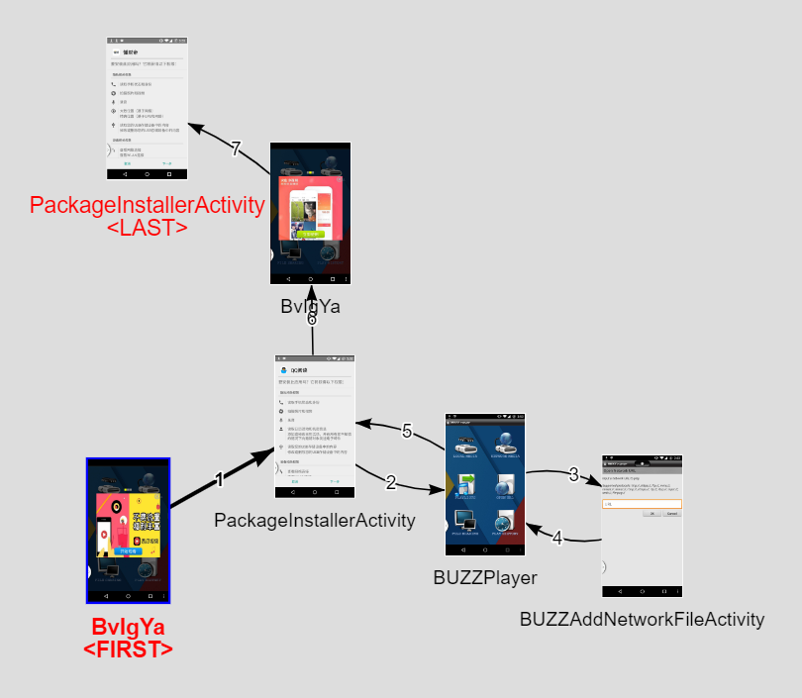
Heuristics-supported ad fraud detection
Fraud #6: Drive-by-Download Ad Fraud
com.bugunsoft.BUZZPlayers

Slide 35
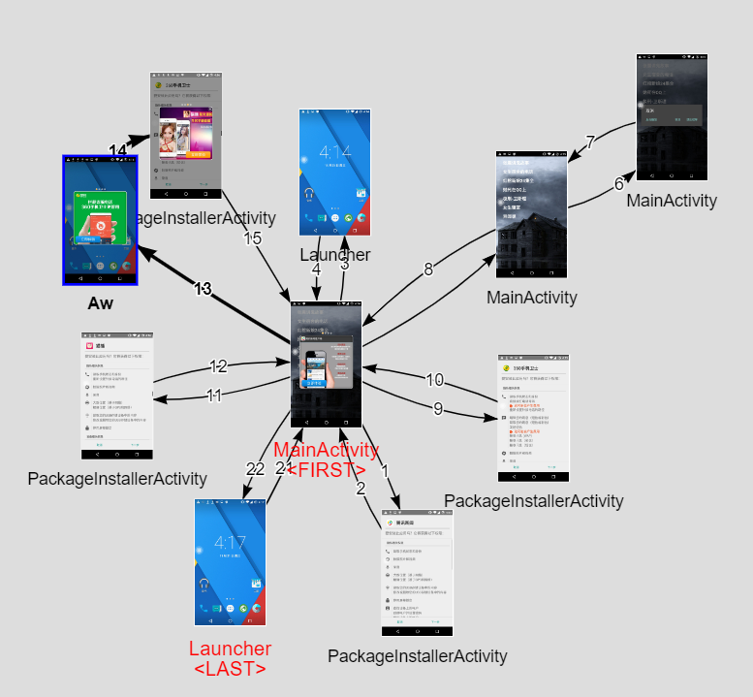
Heuristics-supported ad fraud detection
Fraud #7: Outside Ad
com.ChangStory

Slide 36
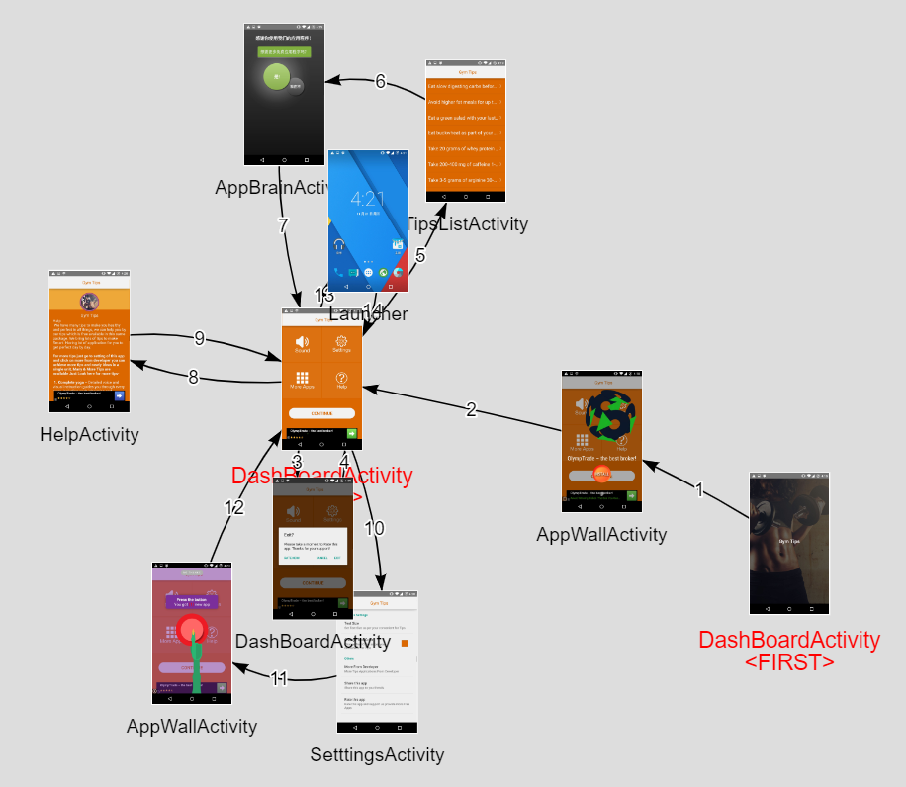
Heuristics-supported ad fraud detection
Fraud #8: Frequent Ad
com.fitness.gym.tips.besttips

Slide 37
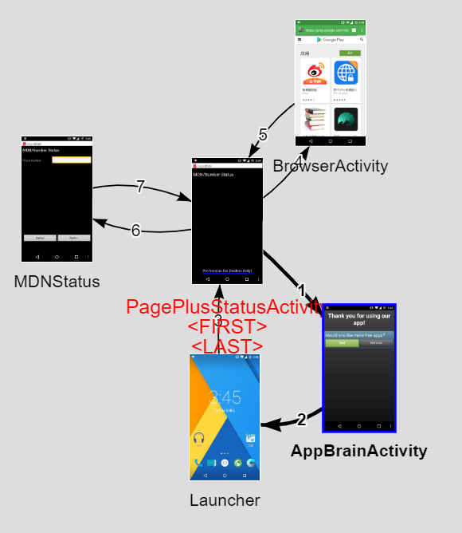
Heuristics-supported ad fraud detection
Fraud #9: Non-content Ad Fraud
com.pageplusstatus

Slide 38
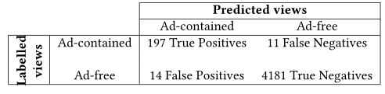
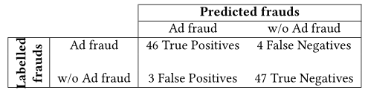
Evaluation
Benchmarks
AdViewBenchmark: 500 apps, 4,403 views, 211 ad views. 93.4% Precision.
AdFraudBench: 100 apps, 50 contained Ad fraud. 93.9% Precision.

Slide 39
Detection in the wild
Dataset
over 3 million Android apps
Identify ad libraries from 20 ad networks represented each in at least 500 apps.
12,000 apps in total
randomly select 500 apps per ad network, 2500 for Admob

Slide 40
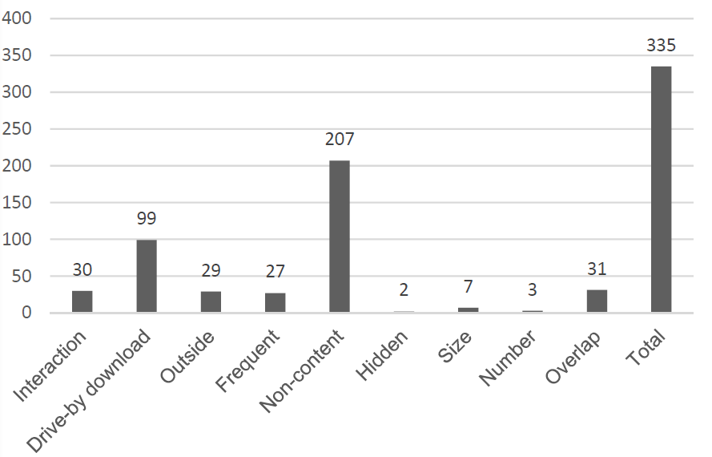
Detection in the wild
Ad fraud distribution by type

Slide 41
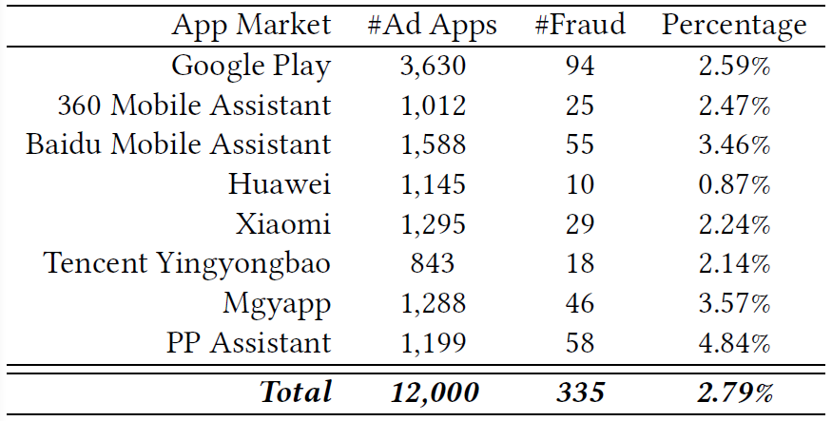
Detection in the wild
Ad fraud distribution by market

Slide 42
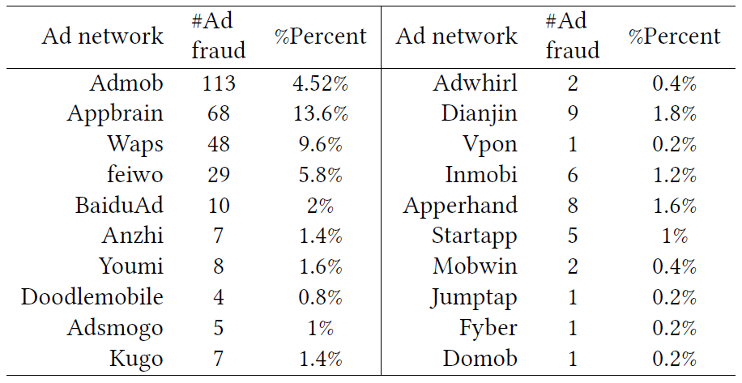
Detection in the wild
Ad fraud distribution by ad network

Slide 43
Conclusion and Take Away Messages
many apps implement advanced procedures for tricking users into unintentionally clicking ad views
build a taxonomy as a reference in the community to encourage the research line on ad fraud detections
devise and implement FraudDroid, a tool-supported approach for accurate and scalable detection of ad frauds
Ad fraud is indeed a real issue in the Android ecosystem (2.79% of apps in our study)
App markets and ad networks should take efforts to identify/prevent fraudulent apps

Slide 44
Thanks!
Haoyu Wang,
Assistant Professor, BUPT,
haoyuwang@bupt.edu.cn

